Slide 1
Aim 3.1 Risk Classification Model
Motivation
Output
Classify patients’ risks of having an above-average Length-of-Stay (LOS) at ICU
A high-low risk categorization of extended (or not) LOS at ICU.
High Risk
A patient is predicted to have a >= 48 hours LOS
Low Risk
A patient is not conclusively predicted to have an above-average LOS
Notes:
Ime

Slide 2
Aim 3.1 Risk Classification Model
Motivation
Output
Data
Classify patients’ risks of having an above-average Length-of-Stay (LOS) at ICU
A high-low risk categorization of extended (or not) LOS at ICU.
25% increase => Elevated PA stiffness
Preoperative
Intraoperative
Post-operative
Demographics
Age
Gender
Type of surgery
Medication
Type (function)
Dosage
Pre and Post bypass Stiffness Index
%increase
Notes:
Ime

Slide 3
Model Development Strategy
Using Classifiers:
KNN (k-nearest neighbors): Nonlinear mapping via NCA, preserves local structure for complex pattern classification.
Support Vector Machine (SVM): Linear kernel with LDA for optimal hyperplane, boosts convergence and accuracy.
NB (NB): Probabilistic with conditional independence and LDA, improves noise/outlier robustness.
Logistic Regression: classification model that uses a logit function to predict the probability of an event occurring with LDA.
Notes:
Ime
KNN (k-nearest neighbors): Enhances performance through Neighborhood Component Analysis (NCA) by learning a nonlinear mapping. This preserves data's local structure, improving classification of complex patterns.
SVM (support vector machine): Utilizes a linear kernel and Linear Discriminant Analysis (LDA) for a superior initial hyperplane, ensuring quicker convergence and heightened accuracy.
NB (naive Bayes): A probabilistic approach that benefits from assuming conditional independence among features, with LDA reducing feature space dimensionality to enhance robustness against noise and outliers.

Slide 4
Model Training Data
Overview
Database
SCG-RHC: Wearable Seismocardiogram and RHC Data
Open access, 73 patients for PAP assessment
Data | Features | Notes
Preoperative | Age, Race, Sex | Basic demographic data
Intraoperative | Blood Pressure | Without medication data
Postoperative | Pulmonary Catheter Waveform Data | Novel feature for evaluation
Notes:
Ime

Slide 5
Model Training Data
Patient Demographics Summary:
Metric | Range | Mean
Age | 26-84 years | 55.53 years
Weight | 40.8125-149.75 kg | 87.83 kg
Height | 149.875-193.0 cm | 172.35 cm
Notes:
Ime

Slide 6
Initial Model Results
KNN Results
NB ReSULTS:
Accuracy: 0.7
Precision: 0.75
Recall: 0.23
F1 Score: 0.35
Accuracy: 0.7
Precision: 0.75
Recall: 0.23
F1 Score: 0.35
SVM Results
Logistic Results:
Accuracy: 0.68
Precision: 1.0
Recall: 0.08
F1 Score: 0.14
Accuracy: 0.7
Precision: 0.75
Recall: 0.23
F1 Score: 0.35

Slide 7
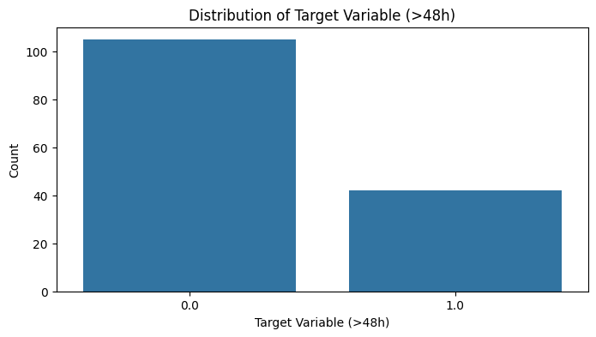
Improving the Model(s)
Using both training and testing data from our dataset to ensure consistency
Additional feature engineering:
Calculating % increase in Stiffness from Pre and Post bypass stiffness to use as a feature instead of the 2 separate features.
Correcting imbalance in target classes (LOS >48h) by:
SMOTE (Synthetic Minority Over-sampling Technique):
generates synthetic examples of the minority class to
balance the dataset and improve model performance
on imbalanced data.
Addition of classifier:
Random Forest Classifier: an ensemble method that builds multiple decision trees and merges their predictions to improve accuracy and control overfitting

Slide 8
New Model Results
KNN Results
NB ReSULTS
RANDOM FOREST Results
Accuracy: 0.70
Precision (Class 1): 0.67
Recall (Class 1): 0.36
F1-Score (Class 1): 0.47
Accuracy: 0.67
Precision (Class 1): 1.00
Recall (Class 1): 0.09
F1-Score (Class 1): 0.17
Accuracy: 0.70
Precision (Class 1): 1.00
Recall (Class 1): 0.18
F1-Score (Class 1): 0.31
SVM Results
Logistic Results
Accuracy: 0.63
Precision (Class 1): 0.50
Recall (Class 1): 0.18
F1-Score (Class 1): 0.27
Accuracy: 0.67
Precision (Class 1): 0.60
Recall (Class 1): 0.27
F1-Score (Class 1): 0.37

Slide 9
Ensemble Method
Voting Classifier method: Combining predictions of all models. he combined prediction is often more accurate than any single model's prediction
Results are same as Random Forest: RF is dominating decision process. Need to improve other model’s performances and confidence.
Voting Results
Accuracy: 0.70
Precision (Class 1): 1.00
Recall (Class 1): 0.18
F1-Score (Class 1): 0.31

Slide 10
Next Steps
Fine tune parameters (using Grid search):
Examples:
KNN: Optimize n_neighbors, calculate and use weights, scale/normalize numeric data, optimize distance metric
Random Forest: Optimize n_estimators and max_depth
Employ Ensemble method (Voting Classifier) to combine predictions from different models
Weight different classifiers by performance
Cross Validation for better performance estimates

Slide 11
Aim 3.2 - Regression Analysis
Outcome
Model
Data
A quantified prediction for a patient’s LOS at ICU compared to clinical average
Support Vector Machine
Nonlinear relationship
Logistic Regression
Linear supervised learning
Intraoperative
Post-operative
Medication
Type (function)
Dosage
Pulmonary Artery (PA) Pressure
% increase from the patient’s own baseline level @T = 0
>= 25% increase => PA stiffness
Notes:
Xinyue
Logistic Regression: popular classification algorithm that can be used for supervised learning tasks. It works by modeling the probability of a binary outcome variable as a function of the input features.
Support Vector Machines: It works by finding a hyperplane that maximizes the margin between the predicted values and the actual values. SVM can handle nonlinear relationships and can be used with different kernel functions to model complex relationships.

Slide 12
Aim 3.3 - Best Feature Validation
Motivation
Approach
Outcome
Is development of pulmonary vascular stiffness indeed a predictor for an increased ICU LOS?
Feature analysis for % contribution
Individual factor?
Combo?
Does %PA pressure increase a (significant) predictor?
A ranked importance of individual factors’ contributions to the prediction outcome
Whether certain % PA increase stands out as an indicator
Notes:
Xinyue
background: it can be the singular/combo factor of medication intervention rather than changes in vascular stiffness that contribute to the differential ICU LOS

Slide 13
Timeline
March
Week 1-2: Aim 3a - Risk Classification Model
Set up, train, and fine-tune risk classification model.
Week 3-4: Aim 3b - Risk Assessment Tool (Regression Modeling)
Develop regression model for hemodynamic instability prediction.
Utilize echocardiographic data, vital signs, and pre-existing risk factors.
April
Week 1-2: Aim 3b (Contd) - Risk Assessment Tool (Regression Modeling)
Continue refining and validate the regression model.
Week 3-4: Overall Project Review and Integration
Integrate three models into a cohesive framework.
Validate the system for consistency and accuracy.
May
Week 1: Finalize Documentation and Presentation
Prepare a comprehensive project report, including findings and insights.
Submit the project report and accompanying materials.
Notes:
Judy

